Slide 1

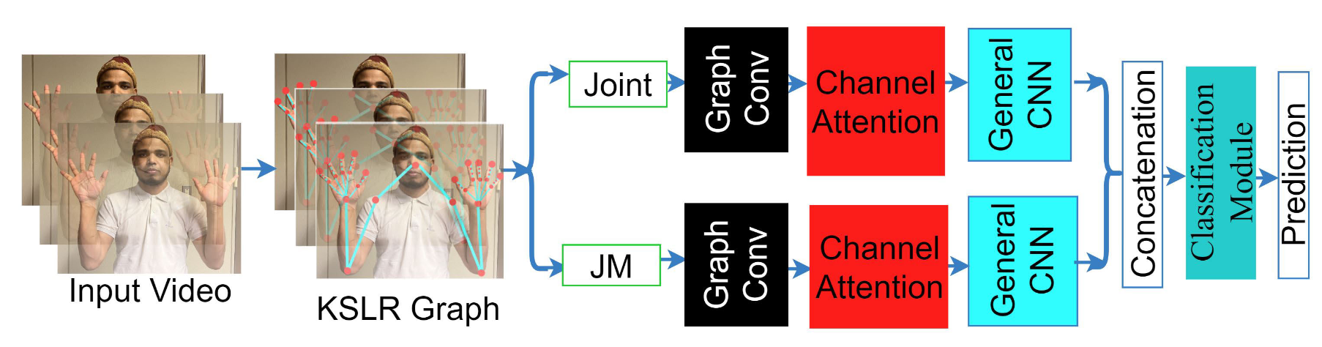
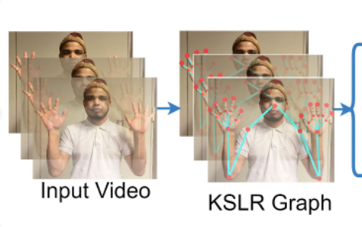
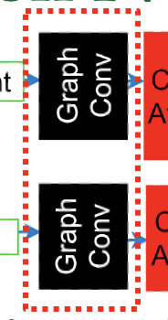
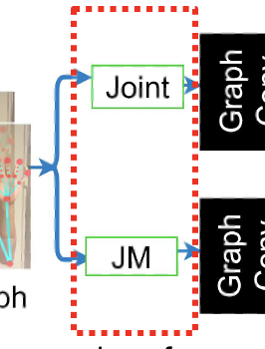
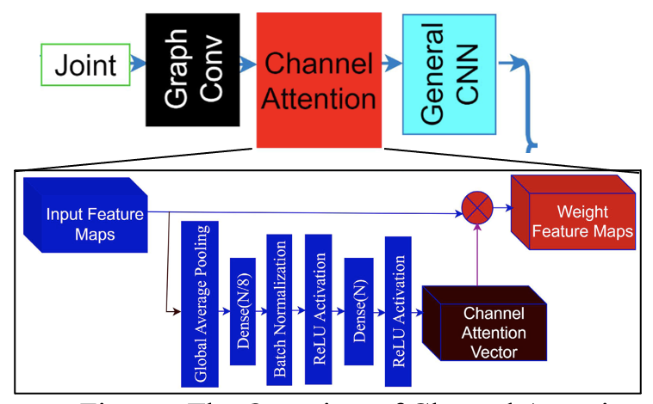
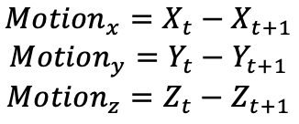
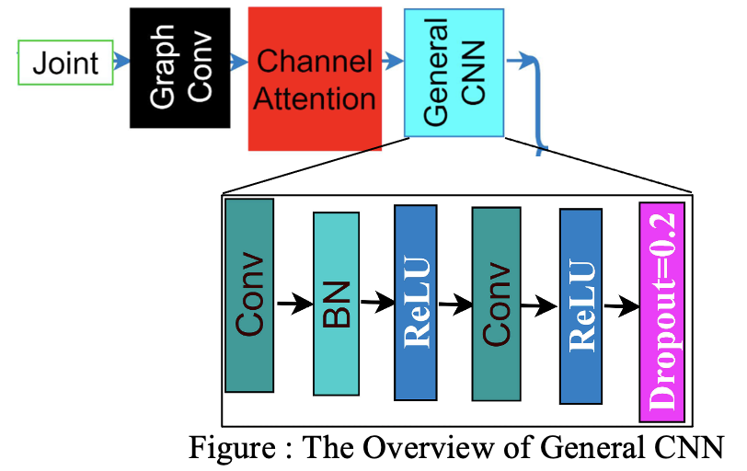
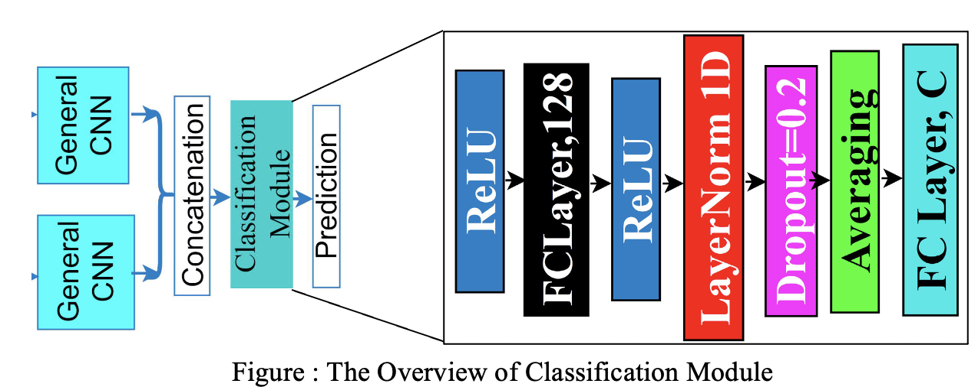
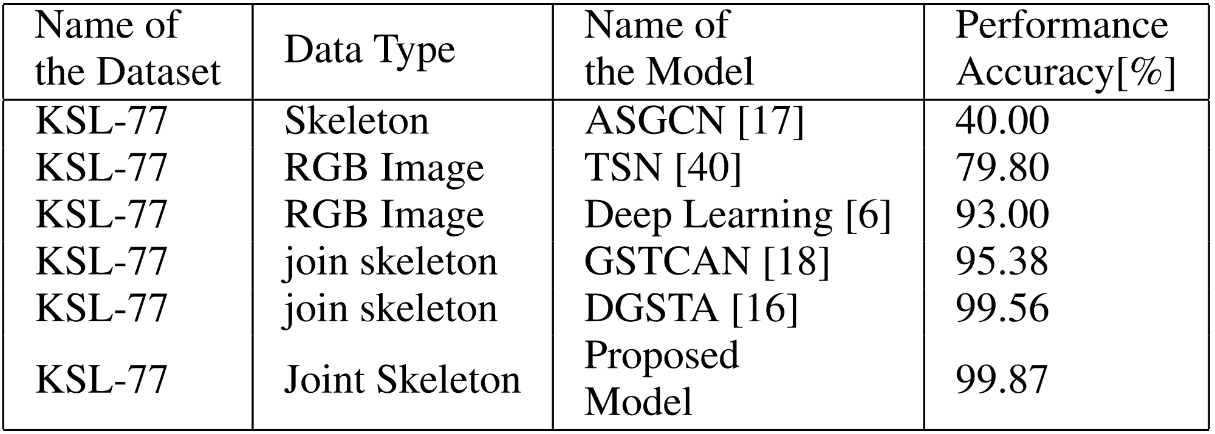
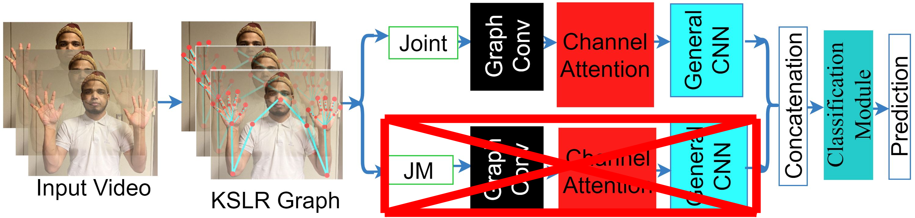
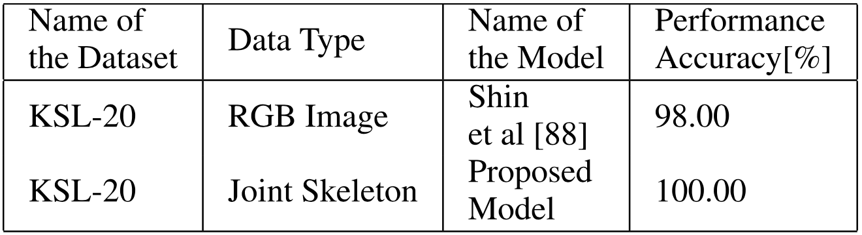
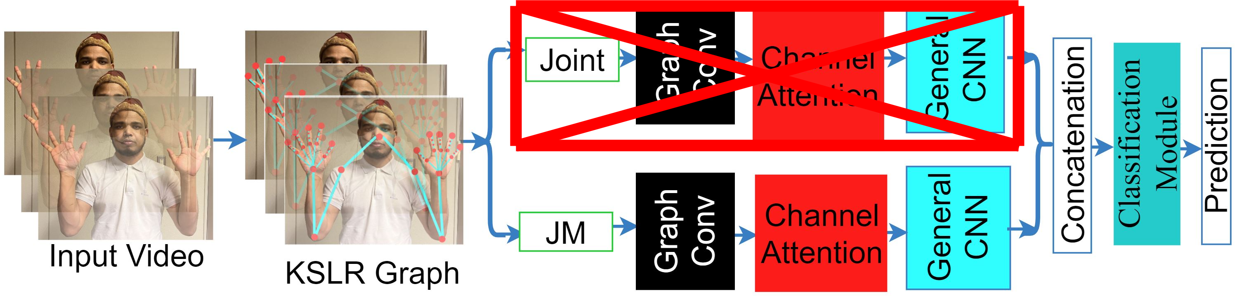
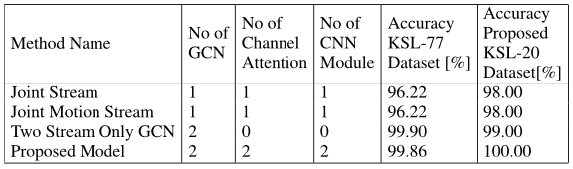
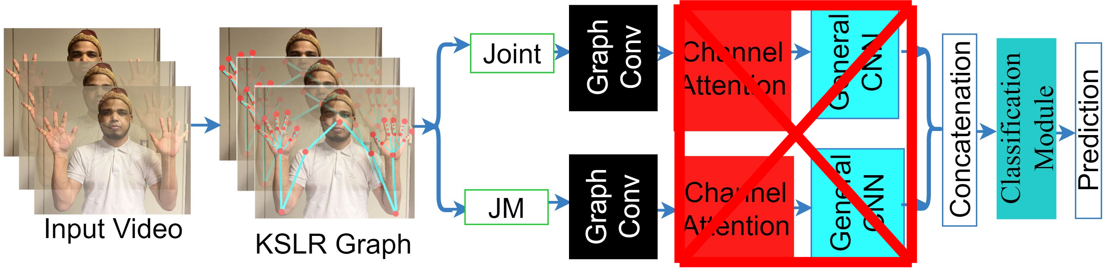
Dynamic Korean Sign Language Recognition Using Pose Estimation Based and Attention-Based Neural Network
PATTERN PROCESSING LAB, SCHOOL OF COMPUTER SCIENCE AND ENGINEERING, UNIVERSITY OF AIZU
INTRODUCTION
The World Health Organization (WHO) reports that approximately 430 million individuals are affected by hearing loss. However, learning sign language is challenging due to the specific motions required to convey various signs. Additionally, most existing research focuses on recognizing sign language using still images and does not consider the detection of dynamic sign words.
Nowadays, a considerable amount of research has been conducted on sign language recognition for various languages, including English, Arabic, Turkish, Indian, and others. However, Korean sign language(KSL) recognition has seen limited development due to the absence of a comprehensive KSL dataset. Additionally, most existing research focuses on recognizing sign language using still images and does not consider the detection of dynamic sign words.
METHODOLOGY
Figure 1 demonstrates the proposed workflow architecture. Recently, some researchers have employed Graph Convolutional Neural Networks (GCNs) for skeleton-based dynamic action recognition.
Our proposed solution involves joint skeleton-based dynamic KSL recognition using two-stream deep learning networks. Each stream incorporates the Graph Convolutional Network (GCN) and an attention-based general neural network approach.
Extracting Skeleton Joint Coordinates
Figure: The overview of our proposed architecture.
Graph Convolutional Network
The study used a MediaPipe system to extract the skeleton joint from the video dataset. We collected 21 skeletons from the left hand, 21 skeleton points from the right and points from the body. In total, there are 47 skeleton key points we extracted here.
The Graph Convolution Network(GCN) model captured and then processed the skeleton graph as structural information based on the relationship among the nodes. In addition, the proposed graph structure captured the spatial relationship and dependencies among the joints.
Capturing Joint Motion
Channel Attention Mechanism
Joint Motion(JM) is a very effective feature for dynamic gestures in terms of alignment and movement and improves the effectiveness of overall skeletal information structures.
In this study, we extracted 47 skeleton points, and captured the motion information for each coordinate separately. The difference in the coordinated point between the consecutive frame joint positions is the concept of this calculation.
We applied the channel attention mechanism on the output of GCN to enhance the representation of features with the channel of a graph. Emphasizing the important feature suppresses the less important feature aiming to improve the generalization and discriminative power of the proposed system. By learning channel-wise weights, it can determine the contribution of each channel to the final representation.
Figure : The Overview of Channel Attention
General CNN
Classification Module
In the stage, we employed a classification module where we included a coupled of the ReLU activation, Coupled of fully connected layer, layer normalization, dropout layer and the averaging pooling layer.
In the stage, we employed a classification module where we included a coupled of the ReLU activation, Coupled of fully connected layers, layer normalization and dropout layer.
ABLATION STUDY
RESULT
In our study, we proposed a model structured with Graph Convolutional Network(GCN) modules spread across joint and joint motion streams with spatial-temporal contextual information enhancement.
Within these, we check the contribution of module or stream by removing the a part of model.
We experimented the following ablation studies.
Using Joint information Only.
Using Joint Motion (JM) information Only.
Using Two Stream without Attention and General-CNN
State-of-the-art comparisons for the existing KSL77 benchmark dataset are shown in Table 1. We can see that the existing model generated 79.80% and 93.00% accuracy, whereas the proposed model produced 99.87% performance accuracy, which is 6% more than the existing method.
Table 2 shows the comparison performance accuracy of the proposed model with the state-of-the-art comparison of the proposed model for the proposed KSL-20 dataset. The proposed model produced 100.00% accuracy, which is much more than the previous system.
Table 1: Comparison for the KSL-77 with the state-of-the-art model.
Table 2: Comparison for the proposed KSL-20 dataset with the state-of-the-art model.
Table 3 shows the Result of Ablation Study. It shows Combining both information is effective for classification, and Attention and General CNN helps to improve accuracy for KSL-20 dataset.
Table 3: The Result of Ablation study experiment.
Cite: Jungpil. Shin, Abu. Saleh. Musa. Miah, Kota. Suzuki, Koki. Hirooka and Md. Al Mehedi Hasan, "Dynamic Korean Sign Language Recognition Using Pose Estimation Based and Attention-Based Neural Network," in IEEE Access, vol. 11, pp. 143501-143513, 2023, doi: 10.1109/ACCESS.2023.3343404.

